Slide 1

“Predicting Risk of Dyslexia”
Sydney Marino
Fall 2020
Notes:
“Dyslexia is a learning disorder that involves difficulty reading due to problems identifying speech sounds and learning how they relate to letters and words “ ~ https://www.mayoclinic.org/diseases-conditions/dyslexia/symptoms-causes/syc-20353552

Slide 2
The Data
Distribution
The Data
# 5,039
Y 540
N 4,499
POriginal197
PCurrent95
R 1
The Goal
Predict Dyslexia
Notes:
“Dyslexia is a learning disorder that involves difficulty reading due to problems identifying speech sounds and learning how they relate to letters and words “ ~ https://www.mayoclinic.org/diseases-conditions/dyslexia/symptoms-causes/syc-20353552
Much harder to see if a student has dyslexia in Spanish speaking countries due to the grammar, spelling, etc.
Could only be told once students were failing
This study and test was created to try to predict dyslexia ahead of time to nip it early on
5039 Participants given a game, 32 questions, to predict if they had dyslexia or not
Originally 197 predictors, reduced to 95 due reduce redundancy and delete NULL predictors
Response variable: If the person has dyslexia (Y/N)
540 participants (12%) have dyslexia, 4,499 do not have dyslexia (88%)
Goal: Predict dyslexia among Spanish speaking students to aid them early on

Slide 3
The Data
Features
Demographic
Exam Results
Sex
Age
Desktop/Tablet
Native_Lang
Other_Lang
ClicksX
AccuarcyX
MissrateX
Notes:
Much harder to see if a student has dyslexia in Spanish speaking countries due to the grammar, spelling, etc.
Could only be told once students were failing
This study and test was created to try to predict dyslexia ahead of time to nip it early on
Gender – even
Age – left skewed
More non native
More people failed class
More desktop

Slide 4
Models
GLMs (3)
Binomial
CV-10
50 Samples
Random Forest
Ntree = 500
Mtry = p/3
50 Samples
Notes:
RF slowest, better CI, but for AUC for all data is lowest

Slide 5
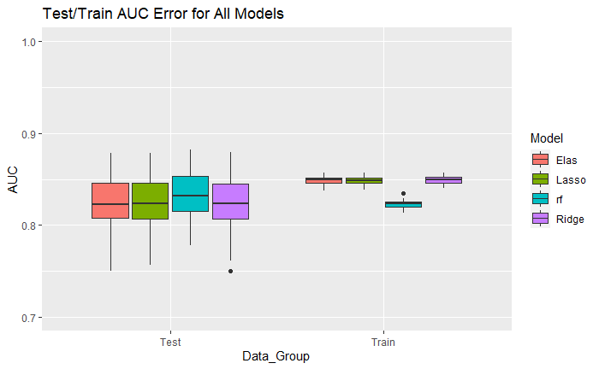
Model Analysis – AUC of 50 Samples
Notes:
Train AUC is higher for Lasso/Ridge/Elas
RF test train AUC on par with eachother

Slide 6
Models
Models | Fitting Time CV and Model(Seconds) Full Data | 90% CI AUC
Lasso | 8.8 | 0.8208, 0.8221
Ridge | 9.2 | 0.8207, 0.8221
Elastic | 6.5 | 0.8206, 0.8220
Random Forest | 12.6 | 0.8302, 0.8317
Notes:
RF slowest, better CI, but for AUC for all data is lowest

Slide 7
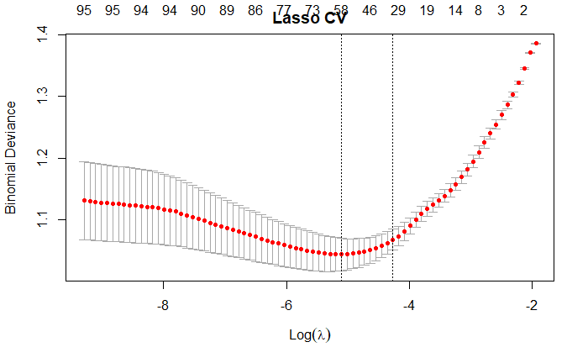
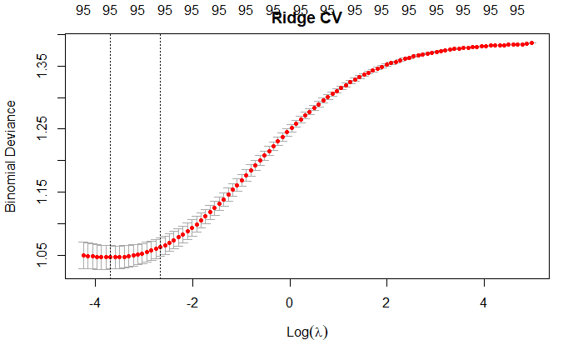
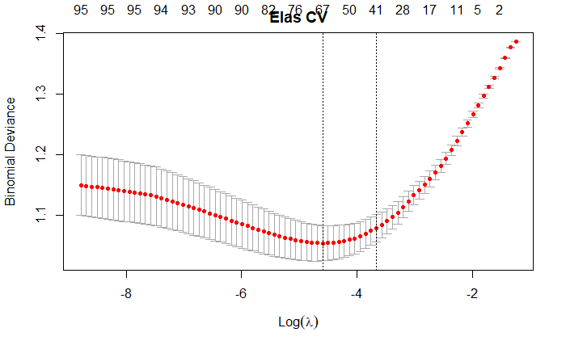
Model Analysis – CV Plot
Notes:
Lasso/Ridge/Elas similar in ranking, doesn’t seem to like most variables
RF uses most and forces more on the exam rather than demographics

Slide 8
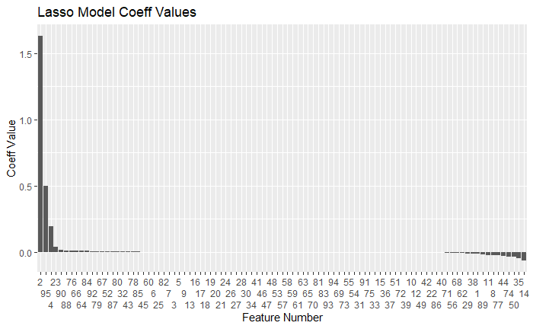
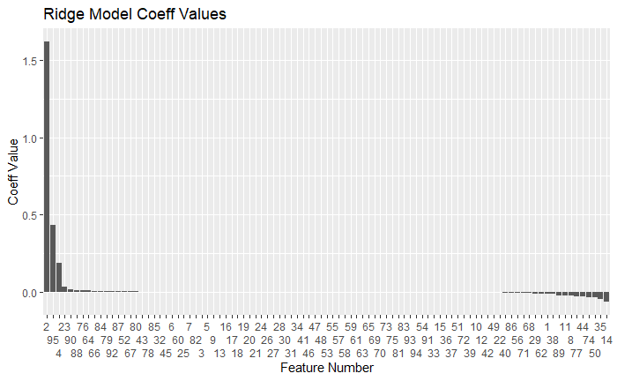

Model Analysis – Importance/Coefficients
Notes:
Lasso/Ridge/Elas similar in ranking, doesn’t seem to like most variables
RF uses most and forces more on the exam rather than demographics

Slide 9
Model Analysis – Importance/Coefficients
Notes:
Lasso/Ridge/Elas similar in ranking, doesn’t seem to like most variables
RF uses most and forces more on the exam rather than demographics

Slide 10
Conclusion
Model | Time | Performance | Overall?
Lasso, Ridge, Elas | Optimal | Poor | Not Good
Random Forest | Poor | Optimal | Good

Slide 11
Reference/Resources
Data: https://www.kaggle.com/luzrello/dyslexia
Code: https://github.com/SydneySHartman/STA9891_Dsylexia
Variable | Description | Possible Values
Sex | Sex of participant | M, F
Nativelang | Is Spanish the participant’s native language? | Y, N
Otherlang | Has participant failed language class at least once? | Y, N
Age | Age of participant | 7-17
Desktop_Tablet | Test conducted on tablet or desktop? | D, T
ClicksX | Total # of clicks for question X | Integer
AccuracyX | % of correct clicks for question X | 0-1
MissrateX | % of miss clicks for question X | 0-1

Slide 12
Reference/Resources
Feature | Number
Sex | 1
Nativelang | 2
Otherlang | 3
Age | 4
Clicks1 | 5
Accuracy1 | 6
Missrate1 | 7
Clicks2 | 8
Accuracy2 | 9
Missrate2 | 10
Clicks3 | 11
Accuracy3 | 12
Missrate3 | 13
Clicks4 | 14
Accuracy4 | 15
Missrate4 | 16
Clicks5 | 17
Accuracy5 | 18
Missrate5 | 19
Clicks6 | 20
Accuracy6 | 21
Missrate6 | 22
Clicks7 | 23
Accuracy7 | 24
Missrate7 | 25
Clicks8 | 26
Accuracy8 | 27
Missrate8 | 28
Clicks9 | 29
Accuracy9 | 30
Missrate9 | 31
Clicks10 | 32
Accuracy10 | 33
Missrate10 | 34
Clicks11 | 35
Accuracy11 | 36
Missrate11 | 37
Clicks12 | 38
Accuracy12 | 39
Missrate12 | 40
Clicks13 | 41
Accuracy13 | 42
Missrate13 | 43
Clicks14 | 44
Accuracy14 | 45
Missrate14 | 46
Clicks15 | 47
Accuracy15 | 48
Missrate15 | 49
Clicks16 | 50
Accuracy16 | 51
Missrate16 | 52
Clicks17 | 53
Accuracy17 | 54
Missrate17 | 55
Clicks18 | 56
Accuracy18 | 57
Missrate18 | 58
Clicks19 | 59
Accuracy19 | 60
Missrate19 | 61
Clicks20 | 62
Accuracy20 | 63
Missrate20 | 64
Clicks21 | 65
Accuracy21 | 66
Missrate21 | 67
Clicks22 | 68
Accuracy22 | 69
Missrate22 | 70
Clicks23 | 71
Accuracy23 | 72
Missrate23 | 73
Clicks24 | 74
Accuracy24 | 75
Missrate24 | 76
Clicks25 | 77
Accuracy25 | 78
Missrate25 | 79
Clicks26 | 80
Accuracy26 | 81
Missrate26 | 82
Clicks27 | 83
Accuracy27 | 84
Missrate27 | 85
Clicks28 | 86
Accuracy28 | 87
Missrate28 | 88
Clicks29 | 89
Accuracy29 | 90
Missrate29 | 91
Clicks30 | 92
Accuracy30 | 93
Missrate30 | 94
Desktop_Tablet | 95

Slide 13
Thank You Questions?

